Slide 1
FTC Programming Class

Slide 2

Topics for today
Telemetry
Java Classes and Methods
Motion (continued)

Slide 3
Methods
Methods in Java are functions that perform tasks
Extremely useful to achieve repetitive tasks with minimal code

Slide 4
Method Usage
Need to declare and define the method:
return methodName(argument1, argumentx) {
}

Slide 5
Telemetry
Telemetry allows you to view program status and elements on the driver station phone
Extremely useful for debugging your program
View contents of your variables
Detect where you are in the program

Slide 6
Telemetry Structure/Usage
Principle forms:
telemetry.addData(“Title", “string”); telemetry.update();
telemetry.addData(“Title", variable); telemetry.update();
telemetry.addData(“Title", method); telemetry.update();

Slide 7
Telemetry Examples
String Example:

Slide 8
Match Tasks
Each new season has a set of specific tasks.
Each match always has the same two sessions:
Autonomous (30 seconds long)
Robot is started, and accomplishes the tasks on its own with no driver intervention
Teleop (2 minutes, 30 seconds long)
Drivers operate the robot to accomplish tasks

Slide 9
Typical Tasks
Motion – Robot moves/is driven
Localization/Navigation – Robot goes to a specific spot on field
Recognition – Robot needs to identify certain objects, and tailor program accordingly
Gathering/Intake – Robot acquires game elements
Lifting – Robot selects and moves game elements
Launching – Robot shoots game elements
Placing – Robot places game elements
Latching – Robot affixes to game elements to move them

Slide 10
FTC Programming
FTC uses Android devices for the base program platform
The fundamental programming language is Java
There are three “official” development environments:
Blocks
Onbot Java
Android Studio

Slide 11
Blocks Language
Blocks is a interface that allows you to program a robot without learning Java
Pros:
Start programming quickly
Do not need to learn Java
Cons:
Difficult to do many more advanced tasks
Slooooowwww interface!
Large programs can be almost unusable

Slide 12
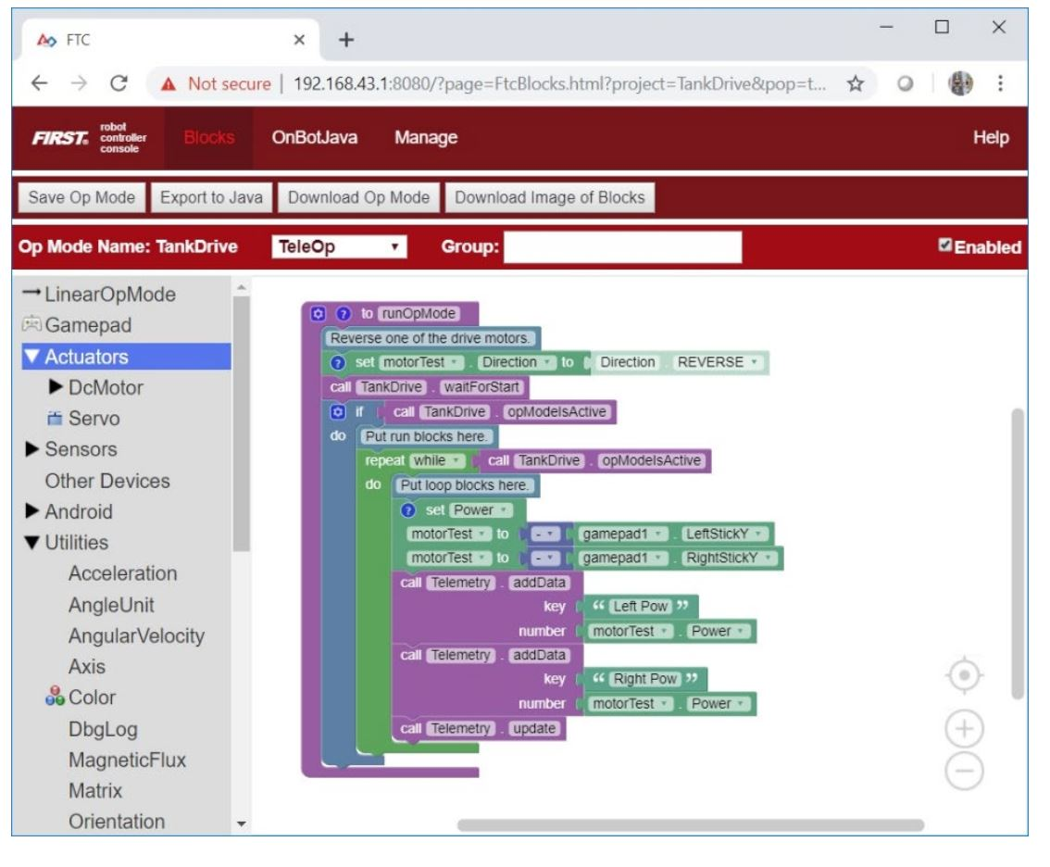
Blocks Language

Slide 13
OnBot Java
Onbot Java is a simplified development tool, using actual Java language
Pros:
Easy to get up and running
Easy for use with multiple programmers on team
Easy to manage software
Cons:
Need to follow process to keep from losing or corrupting the program
Difficult or impossible to do advanced programming features (like some vision programs)

Slide 14
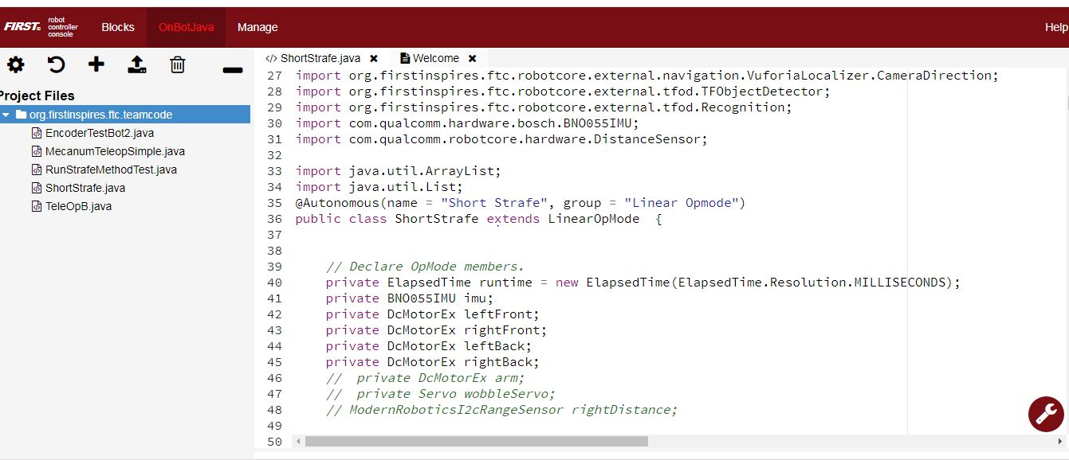
OnBot Java

Slide 15
Android Studio
Android Studio is the professional IDE (Integrated Development Environment) used by programmers that write apps on Android phones
Pros:
Flexible
Can write more advanced Java programs using Object Oriented Programming
Cons:
Hard to set up
Not user friendly
Very hard for multiple users

Slide 16
TDT Coach Recommendation
Recommend OnBot Java for this season
Need to learn some basics, but do not need to become experts
Has the power to do what needs to be done
Can reuse Java code from previous season

Slide 17
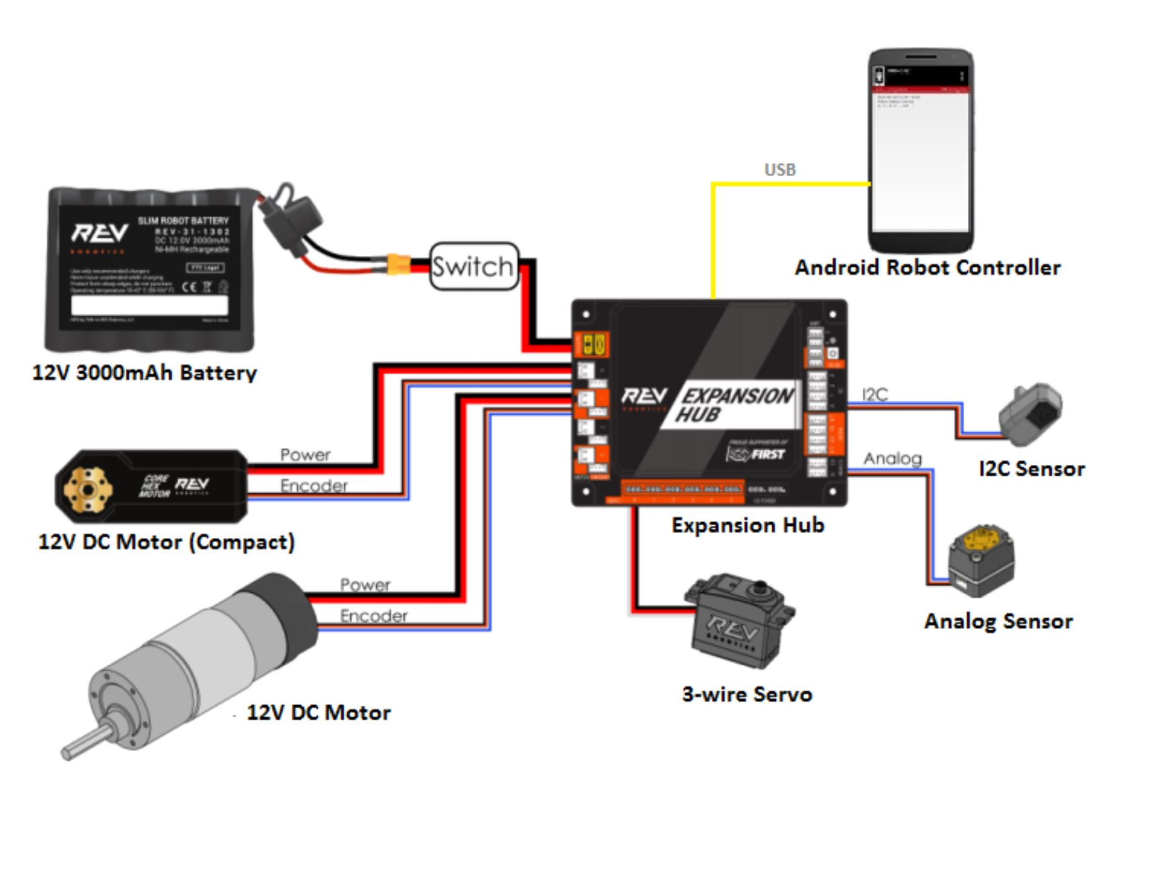
Basic FTC Control Architecture

Slide 18
Opmodes
Opmodes are the programs that control the robot
Two key types of opmodes:
Linear Opmode:
Used for Autonomous
Runs through the program only once
Iterative Opmode:
Used for Teleop
Runs as a continuous loop

Slide 19
Typical Opmode Structure
Header (package imports)
Define Opmode (auto or teleop)
Name the Class
Declare hardware
Declare runopmode
Assign hardware
Set hardware attributes
Wait for Start
Main opmode loop

Slide 20
Java Syntax
Individual statements must end in a semicolon (;)
Methods, loops and other items are bounded in brackets ({)
All bracketed items need to correspond with another bracket if nested

Slide 21
Java Operators
Operators are used to test and assign statements and numbers
Sample operators:
= (assignment)
== (logical equal to)
< (less than)
&& (logical AND)
!= (not equal to)
++ (increment by one)

Slide 22
Data Types/Variables
Java has a wide range of data types
Variables are used to store values
Most common types are:
int (smaller positive and negative whole numbers)
double (larger positive and negative numbers)
boolean (“true” and “false”)

Slide 23
Example of variable usage
Declare the variable
int dogs = 5;
dogs = dogs +10;
dogs = dogs +5;

Slide 24
Conditional if/else
If/else is very powerful tool in programming
It is used to test if certain things have happened or not, and have the program react appropriately
Example:
if (test expression){
do this thing
}
else {
do something different
}

Slide 25
If/else example
int cats =0;
if (dogs ==20){
cats = 50;
}
else {
cats = 100;
}

Slide 26
Loops
Programs are loops
You can set up loops to control actions
Common loops;
while loop
Runs the loop until the test expression is false, then leaves loop
for loop
Runs the loop a specified number of times

Slide 27
while loop example
dogs =0;
cats = 0;
while (dogs < 21){
cats = cats+2;
dogs = dogs +1;
}

Slide 28
for loop example
dogs =0;
cats = 0;
public int loop1;
for (loop1=0; loop1 <21; loop1++){
cats = cats+2;
dogs = dogs +1;
}

Slide 29
Motors
FTC motors are DC motors, and can run either in forward or reverse
You need to specify motor rotation in the hardware setup
FORWARD
REVERSE
The command setPower applies power to the motor to have it turn.
The range of setPower is -1 to 1.
0 is no power, .5 is half power, 1 is full power

Slide 30
Motor run modes
The Rev hub has different ways to control the motor running. There are three basic modes:
RUN_WITHOUT_ENCODER
RUN_USING_ENCODER
RUN_TO_POSITION

Slide 31
Motor run modes
RUN_WITHOUT_ENCODER
Simplest mode
Applies raw battery power to motor
RUN_USING_ENCODER
Uses the motor encoder to try to run to a certain speed
RUN_TO_POSITION
Uses the motor encoder to turn the motor to a certain position

Slide 32
Motor Encoders
Most FTC motors have built in encoders
Encoders provide feedback to the Rev hub in the form of “ticks”.
Motors have a specific number of ticks per revolution (for example 1000 ticks per revolution)

Slide 33
Motor Encoders
Using the feedback from the encoders, we can make the robot move a specified distance.
Example:
Suppose your robot wheel is connected direct to motor, and each motor revolution is 1000 ticks.
Your robot wheel is 4 inches in diameter, so the circumference is πD, or 4 X 3.14 = 12.57 inches
This means the robot should move 12.57 inches with every revolution of the motor
1000/12.57 = 79.55 ticks per inch

Slide 34
Simple code to move robot 5 inches
5 inches x 79.55= 398 ticks
(always use whole numbers with int data types!)
int ticks=0;
ticks = leftFront.getCurrentPosition();
while (ticks<398){
leftFront.setPower(.5);
rightFront.setPower(.5);
leftBack.setPower(.5);
rightBack.setPower(.5);
}
leftFront.setPower(0);
rightFront.setPower(0);
leftBack.setPower(0);
rightBack.setPower(0);

Slide 35
Odometry Encoders
Using motor encoders has a major problem: Wheel slippage
This causes inaccurate movement
To solve this, use of “dead wheels” with encoders.

Slide 36
Telemetry
Programming can be very challenging
You WILL have frustrating times when things don’t work like you think they should
Telemetry is very powerful tool to help you see what is really happening with your code
Inserting AddTelemetry and Update Telemetry commands in your code gives you feedback

